Slide 1
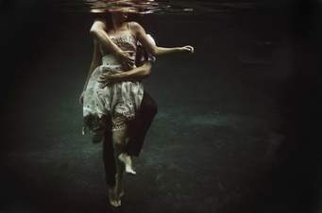
The Unbecoming of Mara Dyer
By Michelle Hodkin
Presentation by Lexus Collins

Slide 2
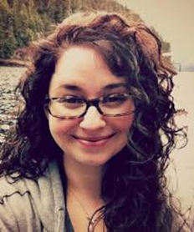
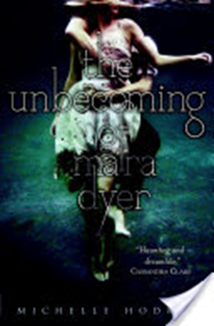
Title: The Unbecoming of Mara Dyer
Author: Michelle Hodkin
Genre: Psychological/Paranormal Thriller
Copyright Date: 2011

Slide 3
Summary
Mara dyer awakes in the hospital with no recollection of the night before. She finds out that she and her friends were in an accident. Mysteriously, she is uninjured but her friends are dead. She moves to get a fresh start. But the move isn’t so refreshing. Mara is seeing her dead friends constantly and Is predicting people’s deaths right before they happen. She thinks she may be going crazy. Is she right?

Slide 4
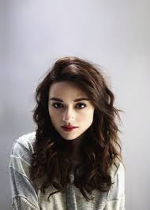
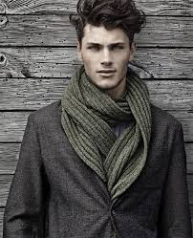
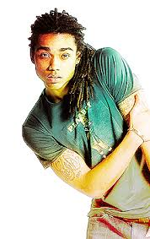
Characters
Mara Dyer
Noah Shaw
Jamie Roth
She is the main character. Mara is not normal. She is seeing dead people and predicting deaths. But she is also strong and determined to find out what happened to her.
Noah is the unkempt annoyingly charming love interest of Mara. He is truly a mystery and there be than meets the eye.
He is Mara’s best friend. He is sarcastic, witty and all around amazing. One of my favorite characters of all time.

Slide 5
Favorite Aspects
Imagery
Michelle hodkin has an amazing imagery that makes every word feel beautiful.
Excerpt: “The ornate script on the board twisted in the candlelight, making the letters and numbers dance in my head.“
Genre
I haven’t explored this genre much but this book makes me interested. The struggle Mara is going through is very intriguing and makes you want more. Her hallucinations and paranoia is shocking and mysterious.

Slide 6
An Excerpt
“My feet pounded the pavement, wishing they could trample the smile on that piece of filth’s face. And as the thought spiked through my brain, I saw it. The redneck’s skull caved in, leaving a gaping pulpy hole in the side of his head. A thick cloud of flies clogging his mouth. Blood staining the sandy dirt by the lumber pile in a wide, darkening pool around his body.
He deserved to die.” – Pg. 72 The Unbecoming of Mara dyer by michelle hodkin

Slide 7
If you want...
Intrigue.
Love.
OR to doubt if anything is real.
I suggest you read this BOOK.

